Slide 1
Artificial Neural Network (ANN)
Arif Istiake Sunny
sunny1509006@gmail.com

Slide 2
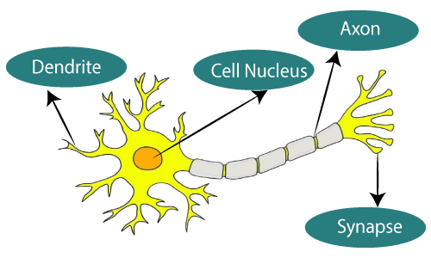
Neurons
Neurons are information messengers. They use electrical impulses and chemical signals to transmit information between different areas of the brain, and between the brain and the rest of the nervous system. Everything we think and feel and do would be impossible without the work of neurons and their support cells
The given figure illustrates the typical diagram of Biological Neural Network.

Slide 3
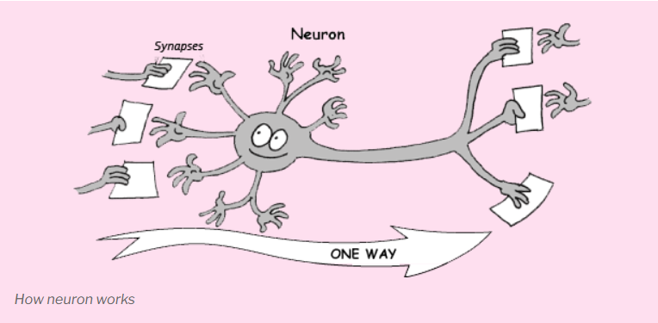
Biological Neural Network (BNN)

Slide 4
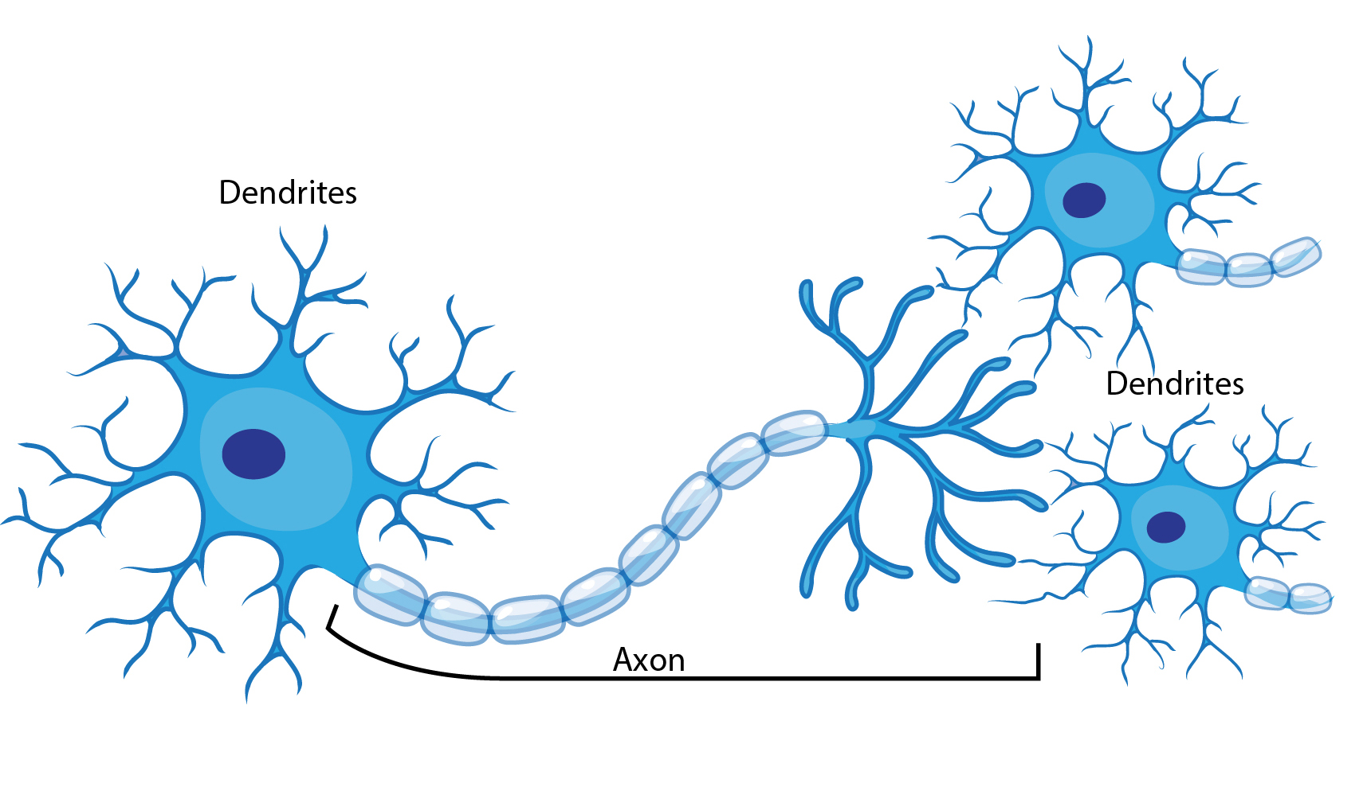
Biological Neural Network (BNN)

Slide 5
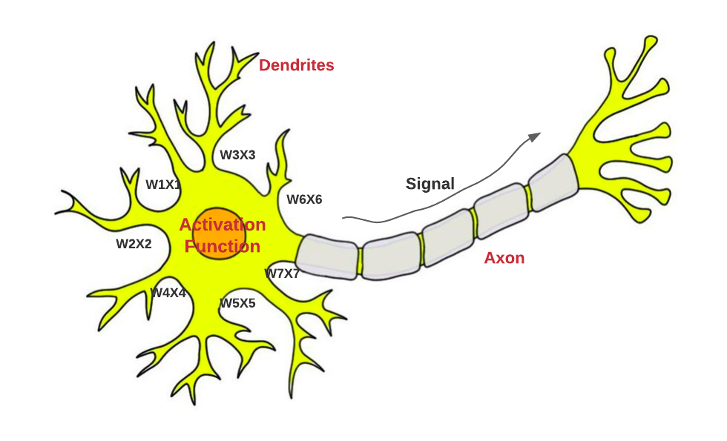
Biological Neural Network (BNN)

Slide 6
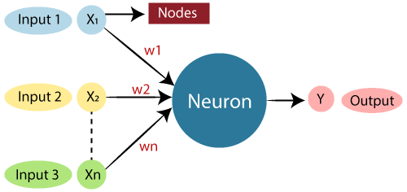
Artificial Neural Network (ANN)
The term "Artificial Neural Network" is derived from Biological neural networks that develop the structure of a human brain. Similar to the human brain that has neurons interconnected to one another, artificial neural networks also have neurons that are interconnected to one another in various layers of the networks. These neurons are known as nodes.
The typical Artificial Neural Network looks something like the given figure.

Slide 7
Artificial Neural Network (ANN)
Biological Neural Network | Artificial Neural Network
Dendrites | Inputs
Cell nucleus | Nodes
Synapse | Weights
Axon | Output

Slide 8
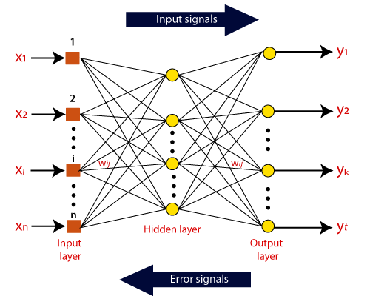
How do ANN works

Slide 9
The Architecture of
Artificial Neural Network (ANN)
Input Layer:
As the name suggests, it accepts inputs in several different formats provided by the programmer.
Hidden Layer:
The hidden layer presents in-between input and output layers. It performs all the calculations to find hidden features and patterns.
Output Layer:
The input goes through a series of transformations using the hidden layer, which finally results in output that is conveyed using this layer.

Slide 10
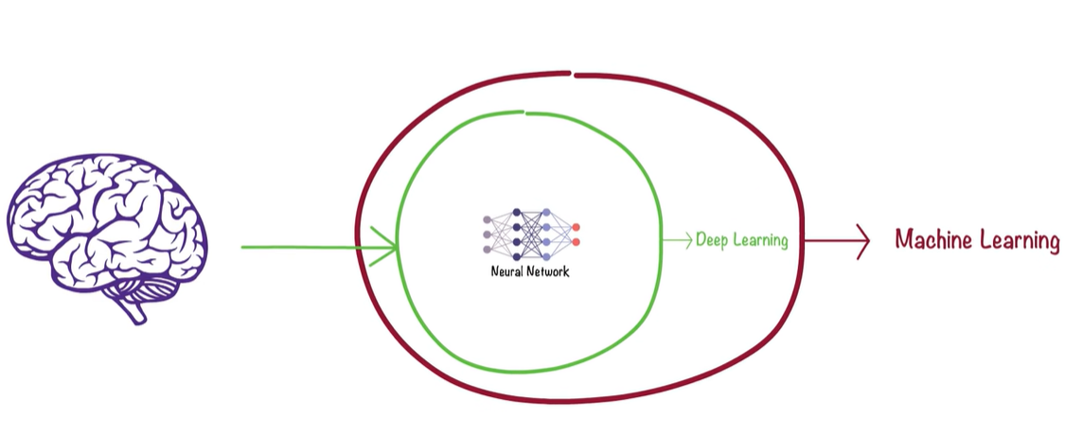
Neural Network

Slide 11
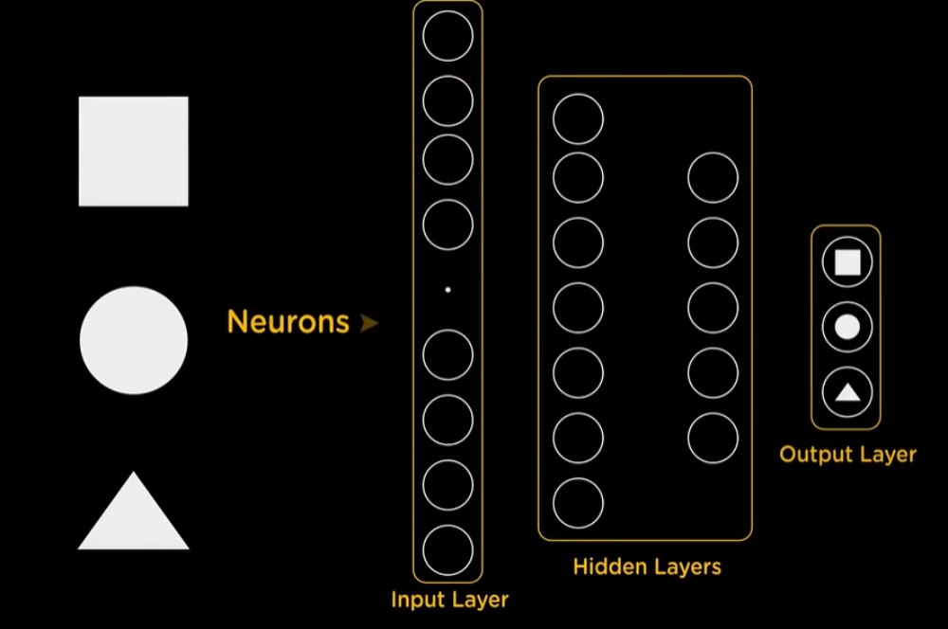
Neural Network

Slide 12
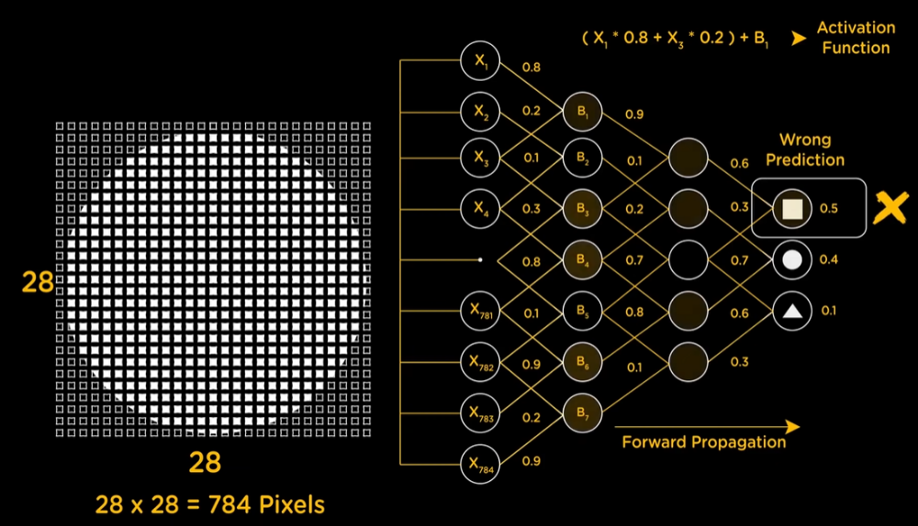
Neural Network

Slide 13
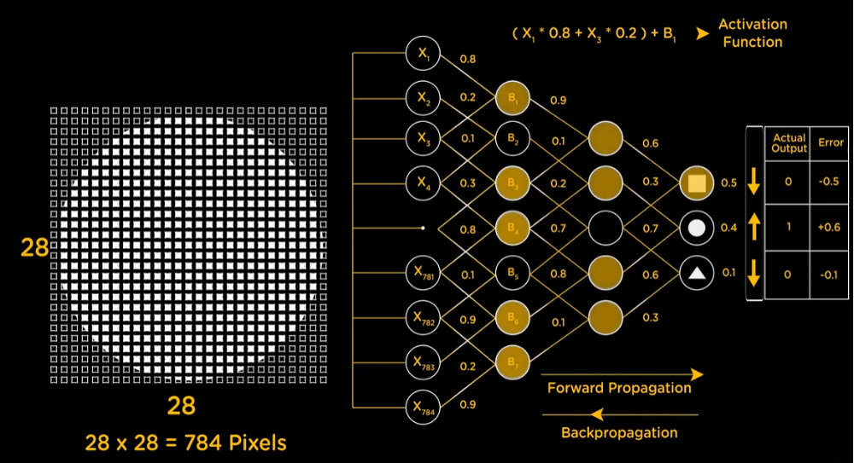
Neural Network

Slide 14
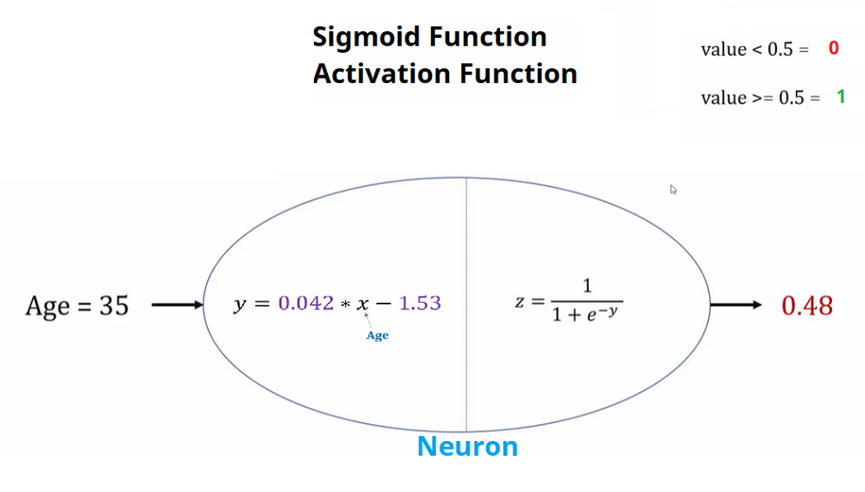
Neural Network

Slide 15
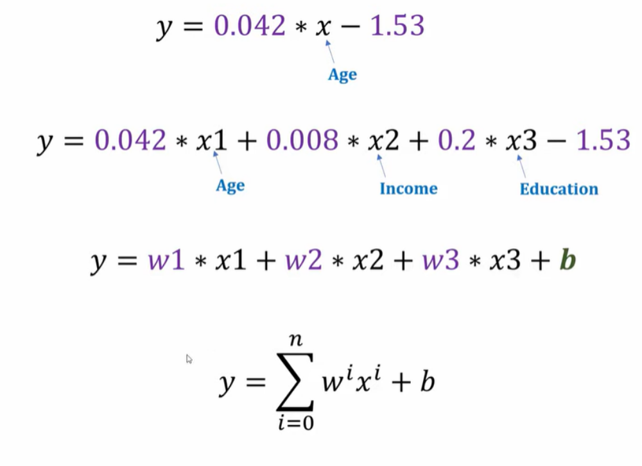
Neural Network

Slide 16
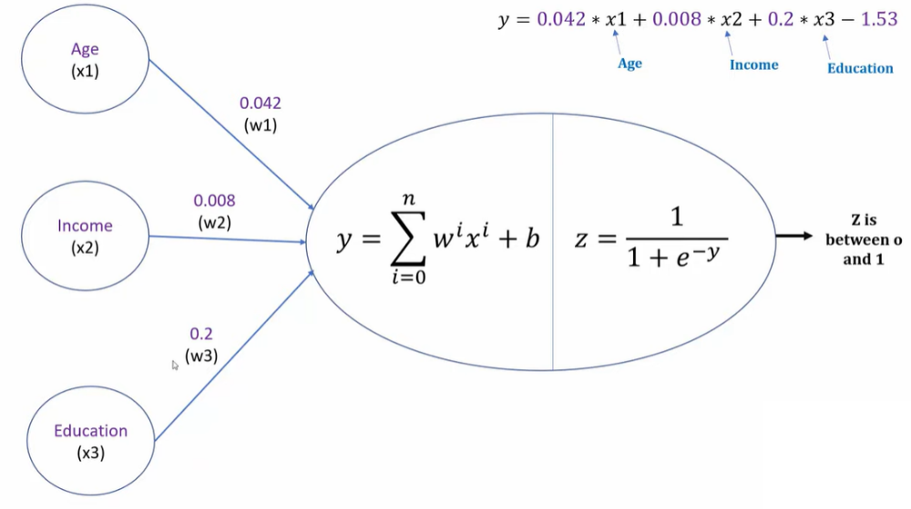
Neural Network

Slide 17
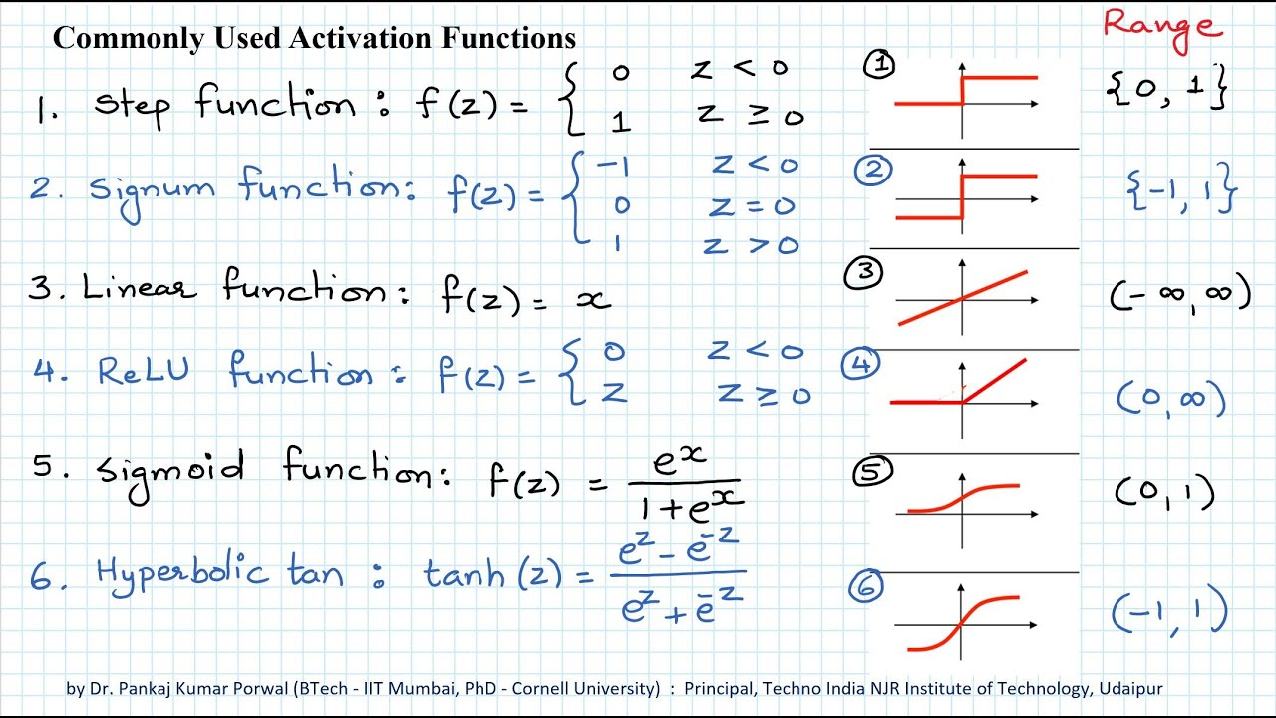
Neural Network

Slide 18
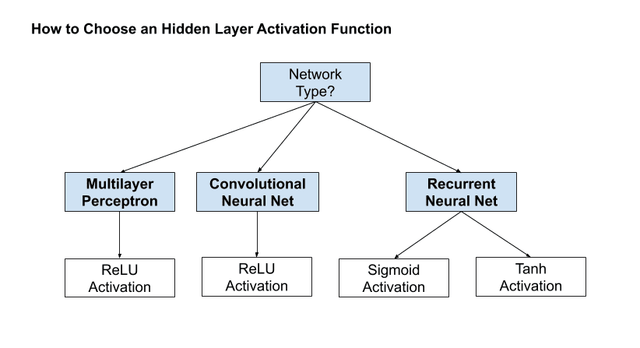
Neural Network

